Slide 1

Department Of Computer Science

Slide 2
Project Title (Valid Title, reflecting scope and objectives)
Student 1 Name
Arslan amin Sp21-bct-005
Student 2 Name
Haleema Saadia Sp21-bct-007
Supervisor:
Mr. TEHSEEN RAZA ABBASI
Department Of Computer Science
Submission Date: 6th-November-2021

Slide 3
Project Category
B- Web Application
E- Smartphone Application
K-Artificial Intelligence and machine learning

Slide 4
Abstract
Out chatbot system will enable the agile and dynamic conversations. This will help in serving huge number of customers at the same time by using their existing resources, FAQs, and knowledge articles. Chatbot system will permit businesses to hook up with clients in a non-public manner without the price of human representatives. Objectives of the chatbot system include cost saving to business, boost efficiency, reduce customers waiting time, solving their daily bases issues, health issues and enhance customer engagement.
chatbot system will provide some personalization by engaging customers in one-on-one conversations, maintaining a natural tone. Chatbot system will communicate with the real person behaving like a human being providing 24/7 service to the customers. Chatbot system will be applicable to the health industry, and for general daily problem solutions.

Slide 5
Research Based Project
No, there is no need to read a research papers for this chatbot system.

Slide 6
Introduction
AI chatbot system is a health related and general problem web based and smartphone-based application to help solving daily health problems and general queries. Through this application one can have check and balance on his/her.
Key goals of the project,
Save Time and Money
-2 Provide After Hours Support 24/7
-3 Guide Users to Better results
-4 Customers engagement
-5 ensure security of consumer
It will have some positive local, international effects and will provide user assistance.

Slide 7
Problem Statement
Usually, people have issue visiting the clinics or getting help from others . Also,people have issues regarding security of their information. The chatbot System will be available to customers 24 hours a day. Will allow them to submit their inquiries regardless of time. chatbot system will comprehend the mind-set of the client by sentence structures and verbal prompts. For health queries Chat Bot system will be a trained Bot that would be able to understand user’s problem and will try to give a proper solution.
Yes, similar features apps exists as that of our app, but re-implementation will help us in learning new technologies like ML, AI, NLP etc. and we will be able to improve our skills.

Slide 8
Problem Solution
As for as the security is concerned, our chatbot system will therefore only ask for relevant data which will only be used to solve their issues or offer personalized experiences. to improve the worth of client correspondence
Through online service user will only use internet to get connected to the app instead of visiting physically.
Different exercises and medications suggestions will help the user.
User will be able to solve some general queries regarding studies education.
User will maintain his personal diary and daily routine reminder.

Slide 9
Related System Analysis/Literature Review
Application Name | Weakness | Proposed Project Solution
LARK | Asks too many personal information hence there exists security risk No use of sentiment analysis Does not keep old conversation record | Our proposed system will only ask the relevant questions, and provide the solutions and results Our system will use sentiment analysis to add value to the customer service Our system will keep record of old conversation.
Wysa | The app's humor offended people, and it doesn't seem to get why the user is annoyed. | In order not to irritate the user, the app will maintain a balance of humor and good behavior. free of charge
Talkspace | didn’t always have the best suggestions | This app will provide the most relevant response that would satisfy the query of user

Slide 10
Advantages/Benefits of Proposed System
App will save time and money of the user.
Improves users’ satisfaction.
Answer questions from the user.
Will Makes the suggestions available to the person even without leaving his/her place.
System will be available 24/7 to the user.
System lessons the security risk by limiting the user’s sensitive information. Only required information is gathered from the user. Keeps the data confidential.
System may save 50% of the expenses of the users by shifting the activities to online rather than physical

Slide 11
Scope
The credibility of a business and the quality of its customer service are two essential aspects of a successful business model. To keep up with the ever-changing world, numerous well-known businesses are now employing chatbots powered by artificial intelligence. The goal of this chatbot system is to lower the work burden on the humans and provide a useful way to the consumers in their daily based task. Also, a check and balance on their health. Everyone needs a personal assistance, so this AI based chatbot is the best system for assessing a user without the interaction of other humans. User work will be easier and efficient.
chat bot will listen all the problems, analyze and recognize user problems and will do counselling by giving and suitable suggestions.

Slide 12
Modules
Module 1: Profile management
Module 2: Daily base communication
Module 3: Registered people management
Module 4: Bot training
Module 5: Health care
Module 6: Generals
Module 7:Sentiment Analysis
Module 8:Chatbot analytics
Module 9:Personal assistance
Module 10:Help and support

Slide 13
Module-1: Profile management
Sign Up:
This will enable the new users/patients to sign up for a new account on the application.
Sign In:
This use case will allow the users/patients to sign-in or log-in for already registered account
Change Avatar:
This use case allows the new users/patients to change the avatar the user selected during sign-up on the app.
Change Password:
This use case allows the new users/patients to change password of the account.

Slide 14
Module-2: Daily base communication
Navigate to Chat Box
Through this action user can navigate to the chat box and can chat with the bot.
Display daily auto generated messages.
Through this action bot will generate a new message in chat box after every 24 hours to interact with the user and the system will display that message on screen
Chat Replies
Through this action bot will reply to user’s messages after going through some machine learning techniques and then retrieving some data from data base (if related data is available) the system will display the resultant
Refresh Chat Box
Through this action bot can refresh the chat box.

Slide 15
Module-3:Registered People Management:
Email id
The email id is kept and managed here.
Customers Data
Customer private and personal data is kept and managed here.
Customers conversations
The conversations among the bot and the customer are kept and managed in this module.
Customers password
The Customers password details are in this module.
Customer problems
All customer problems are added in this module.

Slide 16
Module-4:Bot training
Pre-processed info
In this data related to the daily routine and daily health problems and their recommended solution. Bot will train to the data provided.
Validating of users Messages
When a user sends a message, the message's validity is checked before any ML techniques are applied. If the message contains all special characters, more special characters, or a message that is too short, the system will reject it.
Message Replies
after the process bot will receive the message and bot will try to find a reply for the particular message.
Data storage
The messages and other data must be organized Ly stored in a data base following all operations on the sample messages and incoming user messages, which will be done in this section.

Slide 17
Module-5:Health care
Daily health form
The user will be able to complete a form with some basic questions about health by taking this action. After completing the form, the user will be given recommendations for self-recovery exercises.
Analysis Form
By performing this action, the system will examine the form in accordance with the algorithm, draw conclusions from the form, and then recommend exercises to the user based on the condition.
Exercises
By taking this action, the system will look over the form and tell the user which exercises are best for them.
Every possible solution or exercise
The user can use this action to view all the exercises and solutions, then user move on to any solution.
Relaxation stuff
The user can be able to listen the music or quranic verses for relaxation.

Slide 18
Module-6:Generals
Feeling Alone need to talk
User will have a company when feeling alone
Personal diary
In this user will be able to maintain his personal diary. Can add things he likes.
Motivational support
Issues other than health will be entertained.
Education help
User can share the queries regarding studies and get help.

Slide 19
Module-7:Personal assistance
Daily schedule
user can Set a daily schedule
Remainders
user can Set remainders
Routine planner

Slide 20
Module-8:Sentiment analysis
User input
User talk
Recognizing the sentiment
How the user is feeling
NLP
This bot will be able to comprehend user messages, extract keywords from messages, and possibly generate messages that can be read by humans. Spell checking and other aspects will also be examined.
Intensity of emotion
Judging the intensity of the emotion by the user’s response
Detecting range of emotion
Relevant reply

Slide 21
Module-9:Help and Support
Guide for user
Allows user to view the guideline to use the system.
Tutorials
Having video tutorials
report issues
allows user to report any issue regarding anything and submit
send feedback
allows user to send feedback regarding the application

Slide 22
System Limitations/Constraints
IN case of serious health issues or injuries this System will not be able to entertain the user. However, the user will have to go physically for the treatment.
The chatbot system will be task specific hence poses question based on determined options in health sector.
The user should have a reliable internet connection to access.
The app only uses and understands English language

Slide 23
Software Process Methodology
Process Methodology
Incremental Process Model will be used in the software process methodology. As the requirements are known and there is very low chance that they will be changed so incremental process model is more suitable for this project. The incremental process model has requirements, design, implementation, testing and coding.
Design Methodology
Because some features of the app are dependent on others, some modules are interconnected, and various functionalities share data with one another, we will employ an object-oriented methodology. Additionally, the app will be used by a lot of people looking for counseling, so OOP is the best approach for our project. Also, we will be using such programming languages which or object oriented so oop is the best choice

Slide 24
Tools and Technologies
Tools And Technologies | Tools | Version | Rationale
 | 1.MobileMonkey | 1.1.5 | Virtual chatbot
 | 2.TARS | 1.13.1 | Virtual chatbot
 | 3.BOTSIFY | 1.3 | Virtual chatbot
 | 4.BOTKIT | 4.15.0 | Virtual chatbot
 | 5.Wit.ai | 4.1.2 | Virtual chatbot
 | 6.Replika | 10.2.0 | Virtual chatbot
 | 7.Chatfuel | 1.0.4 | Virtual chatbot
 | 1.AI | 0.0.1 | Programming language
 | 2.NLP | 4.3.0 | Programming language

Slide 25
Project Stakeholders and Roles
Project Sponsor | Mr. Tehseen Riaz Abbasi Comsats University Islamabad, Islamabad campus Comsats University Islamabad is the project's executive sponsor, and it is responsible for the project's success by providing resources and support.
Stakeholder | The project supervisor is Mr. Tehseen Riaz Abbasi. He will observe and see our project coordination from start to end. Uses project management approaches and tools to guarantee that projects meet their objectives in terms of scope, schedule, and money. The project's team members are Arslan Amin and Haleema Saadia. They oversee carrying out specific project tasks in order to meet the project's

Slide 26
Team Members Individual Tasks/Work Division
Student Name | Student Registration Number | Responsibility/ Modules
Student 1Name | Arslan amin Sp21-bct-005 | Abstract ,problem statement ,solution, Advantages ,Scope, Gantt chart, Data gathering Modules from 4 to 10
Student 2 Name | Haleema Saadia Sp21-Bct-007 | Tools and technologies, Mockups, references, Conclusion Concepts, System Limitations Modules from 1 to 3

Slide 27
Data Gathering Approach
We generated questionnaires for gathering the data. Also, we observed different people and tried to understand their issues. Questionnaires consist of the experience of people suffering from different problems. The goal was to get an idea of the kinds of questions that users might ask and the kinds of health or general problems cases that might come up. The requirements were developed in accordance with all the usual observations and concepts. In addition, we examined comparable apps to improve the user experience of our app and locate treatments and solutions.

Slide 28
Concepts
Machine Learning
The majority of machine learning is used for machine training in the second module.This will assist in training the bots to respond appropriately to the question based on the user from the database's datasets.
Concepts of Artificial intelligence
Supervised learning
Un supervised learning
Concept NL :
Natural language processing
Sentiment analysis

Slide 29
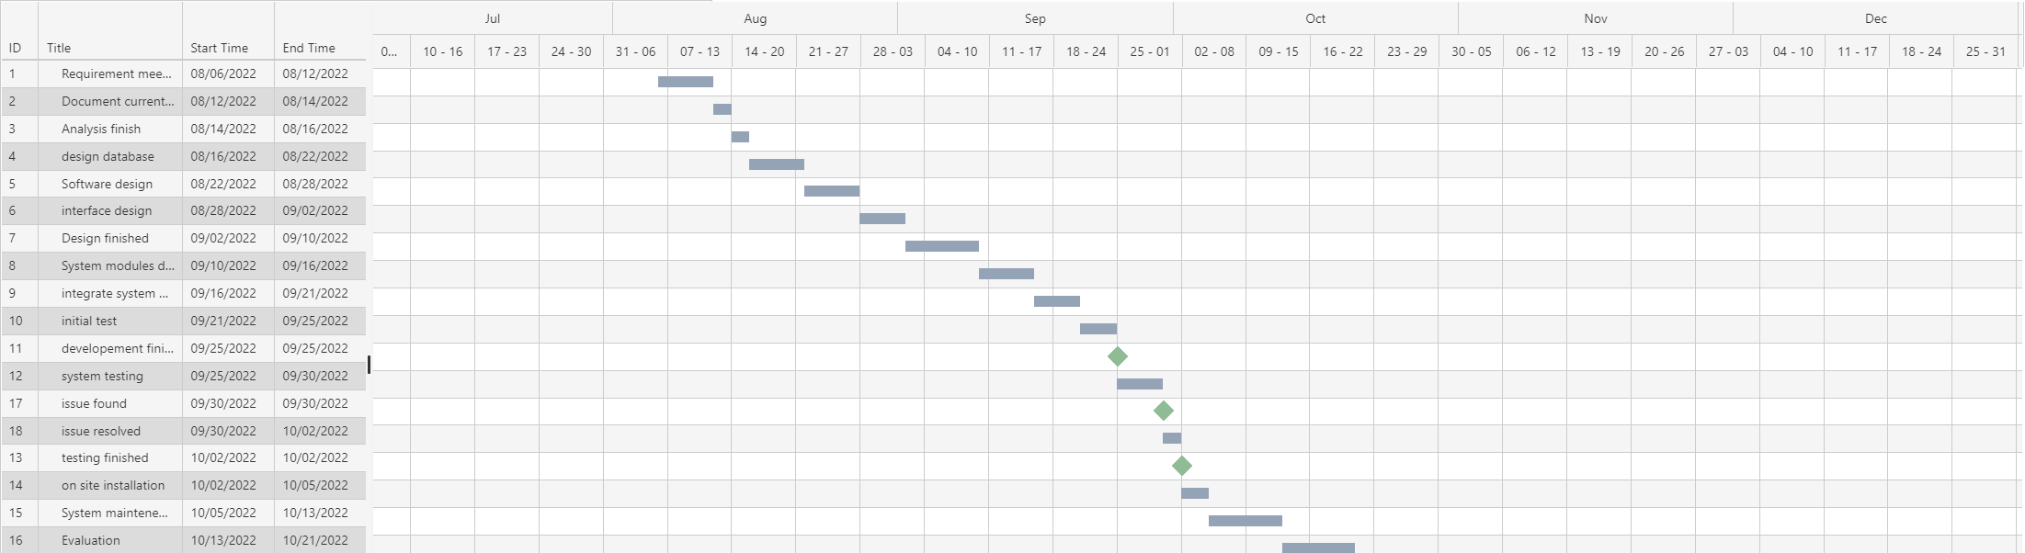
Gantt Chart

Slide 30
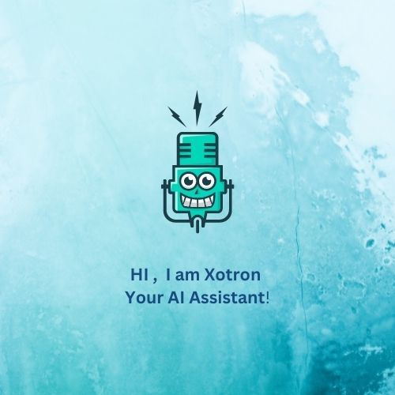
Mockups

Slide 31
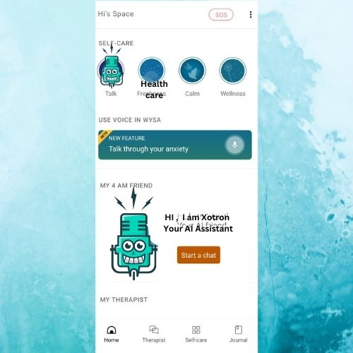
Mockups

Slide 32

Mockups

Slide 33
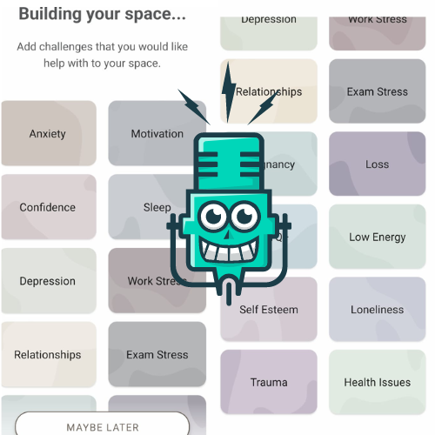
Mockups

Slide 34
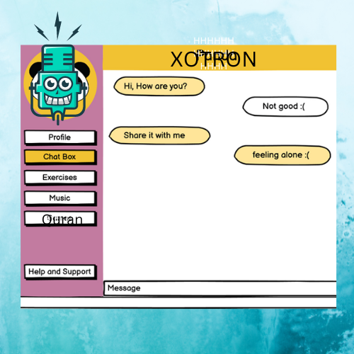
Mockups

Slide 35
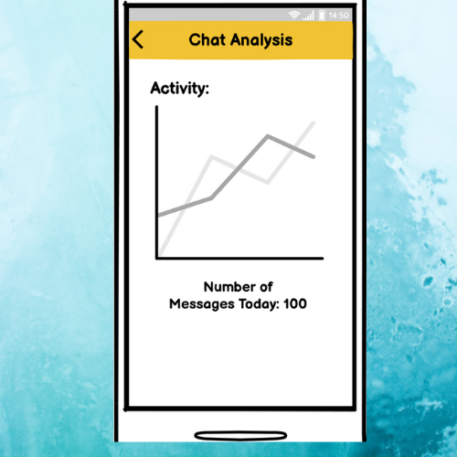
Mockups

Slide 36
Conclusion
Chatbots are effective tools when it comes to education, IR, e-commerce etc. The healthcare chatbot we will create will take care of our customers health and medical routines by reminding them at certain intervals of time. The aim of our chatbot design is a tool built that helps people, facilitate their work, and their interaction with computers using natural language; but not to replace the human role totally, or imitate human conversation perfectly. Even with high volume of customer queries, chatbots can offer the required solutions in no time. Being available always is a strength of chatbots over humans. So, in the AI chatbots vs human scenario, a chatbot is the clear winner

Slide 37
References
https://ui8.net/the-madbrains/products/madbrainsui--chatbot--ai-startup-agencyux
https://www.analyticsvidhya.com/blog/2021/10/complete-guide-to-build-your-ai-chatbot-with-nlp-in-python/
https://vilmate.com/blog/how-to-develop-a-chatbot/
https://youtu.be/1XHp8WrZzoc
https://www.ameyo.com/blog/key-advantages-and-use-cases-of-healthcare-chatbot/
https://geekflare.com/create-chatbot/
https://www.tutorialspoint.com/artificial_intelligence/artificial_intelligence_natural_language_procssing.htm

Slide 38
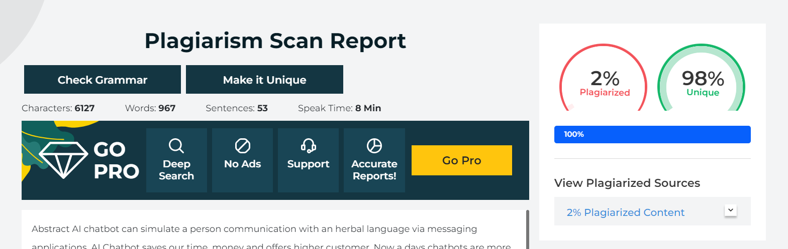
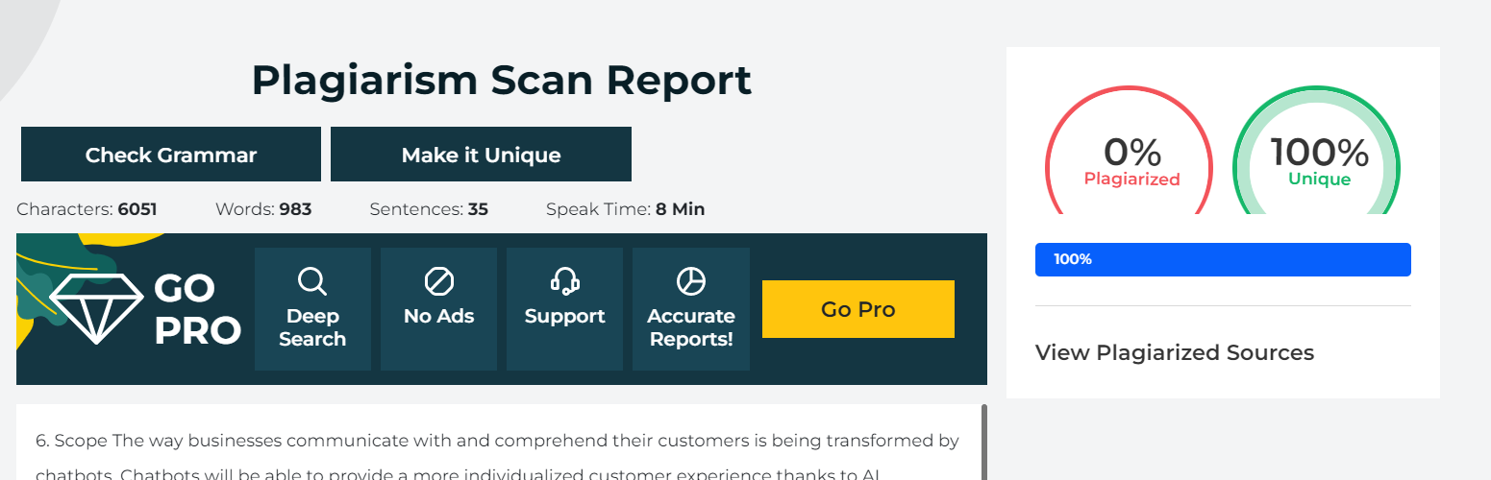
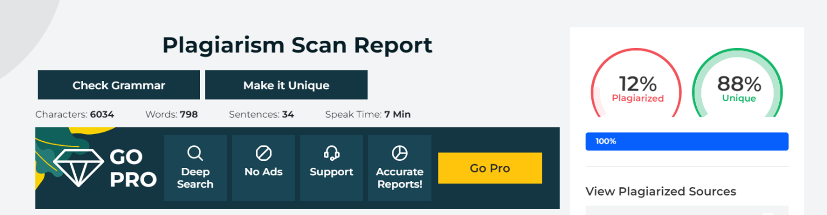
Plagiarism Report:
AVERAGE PLAGIARISM = 2+0+12/3 = 4.67

